Slide 1
Computational Linguistics For People Who Specifically Avoid Computational Linguistics
Marty Taylor • Closed Loop 2019
Notes:
A bizarre set of circumstances

Slide 2
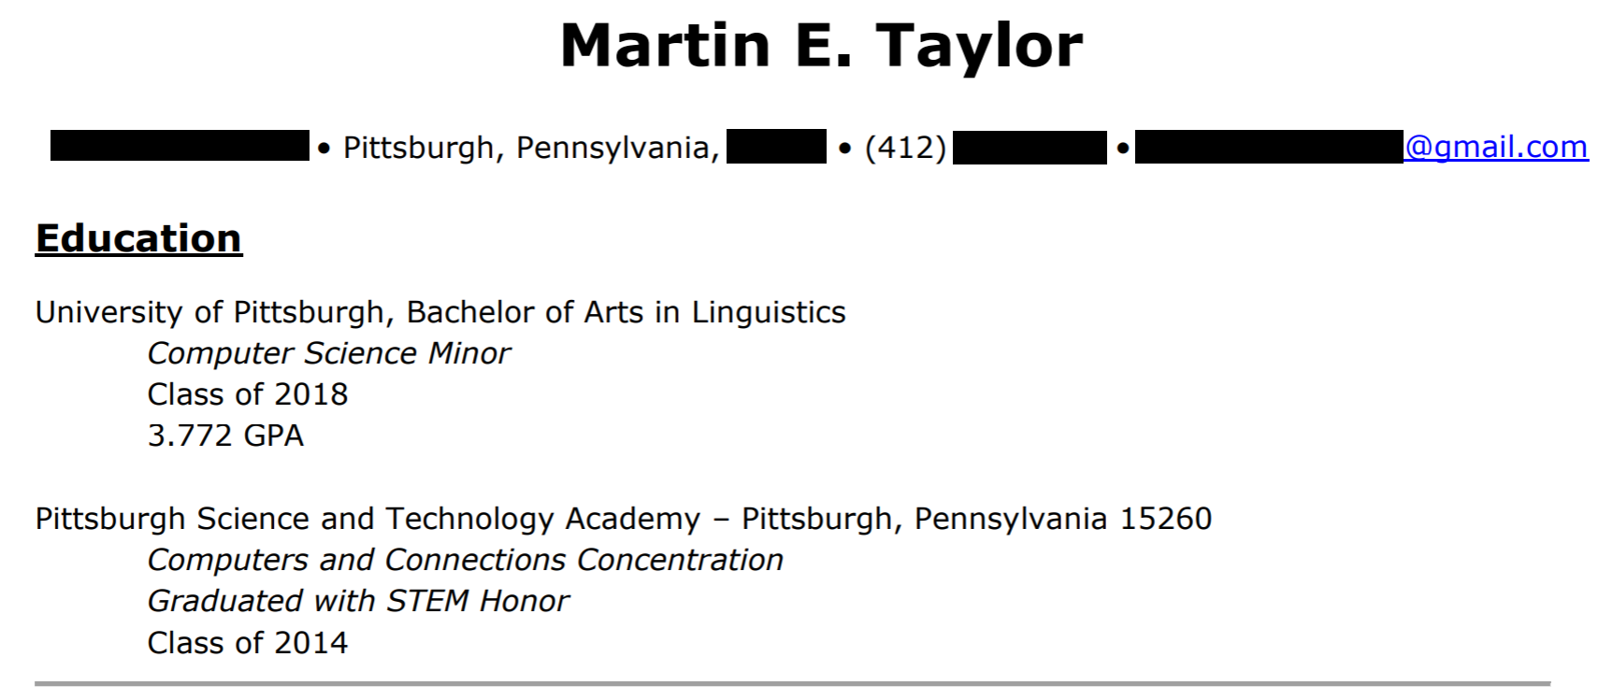
Notes:
Extremely quick rundown of where I’m coming from
I liked CS and Ling but thought they should be two distinct fields

Slide 3
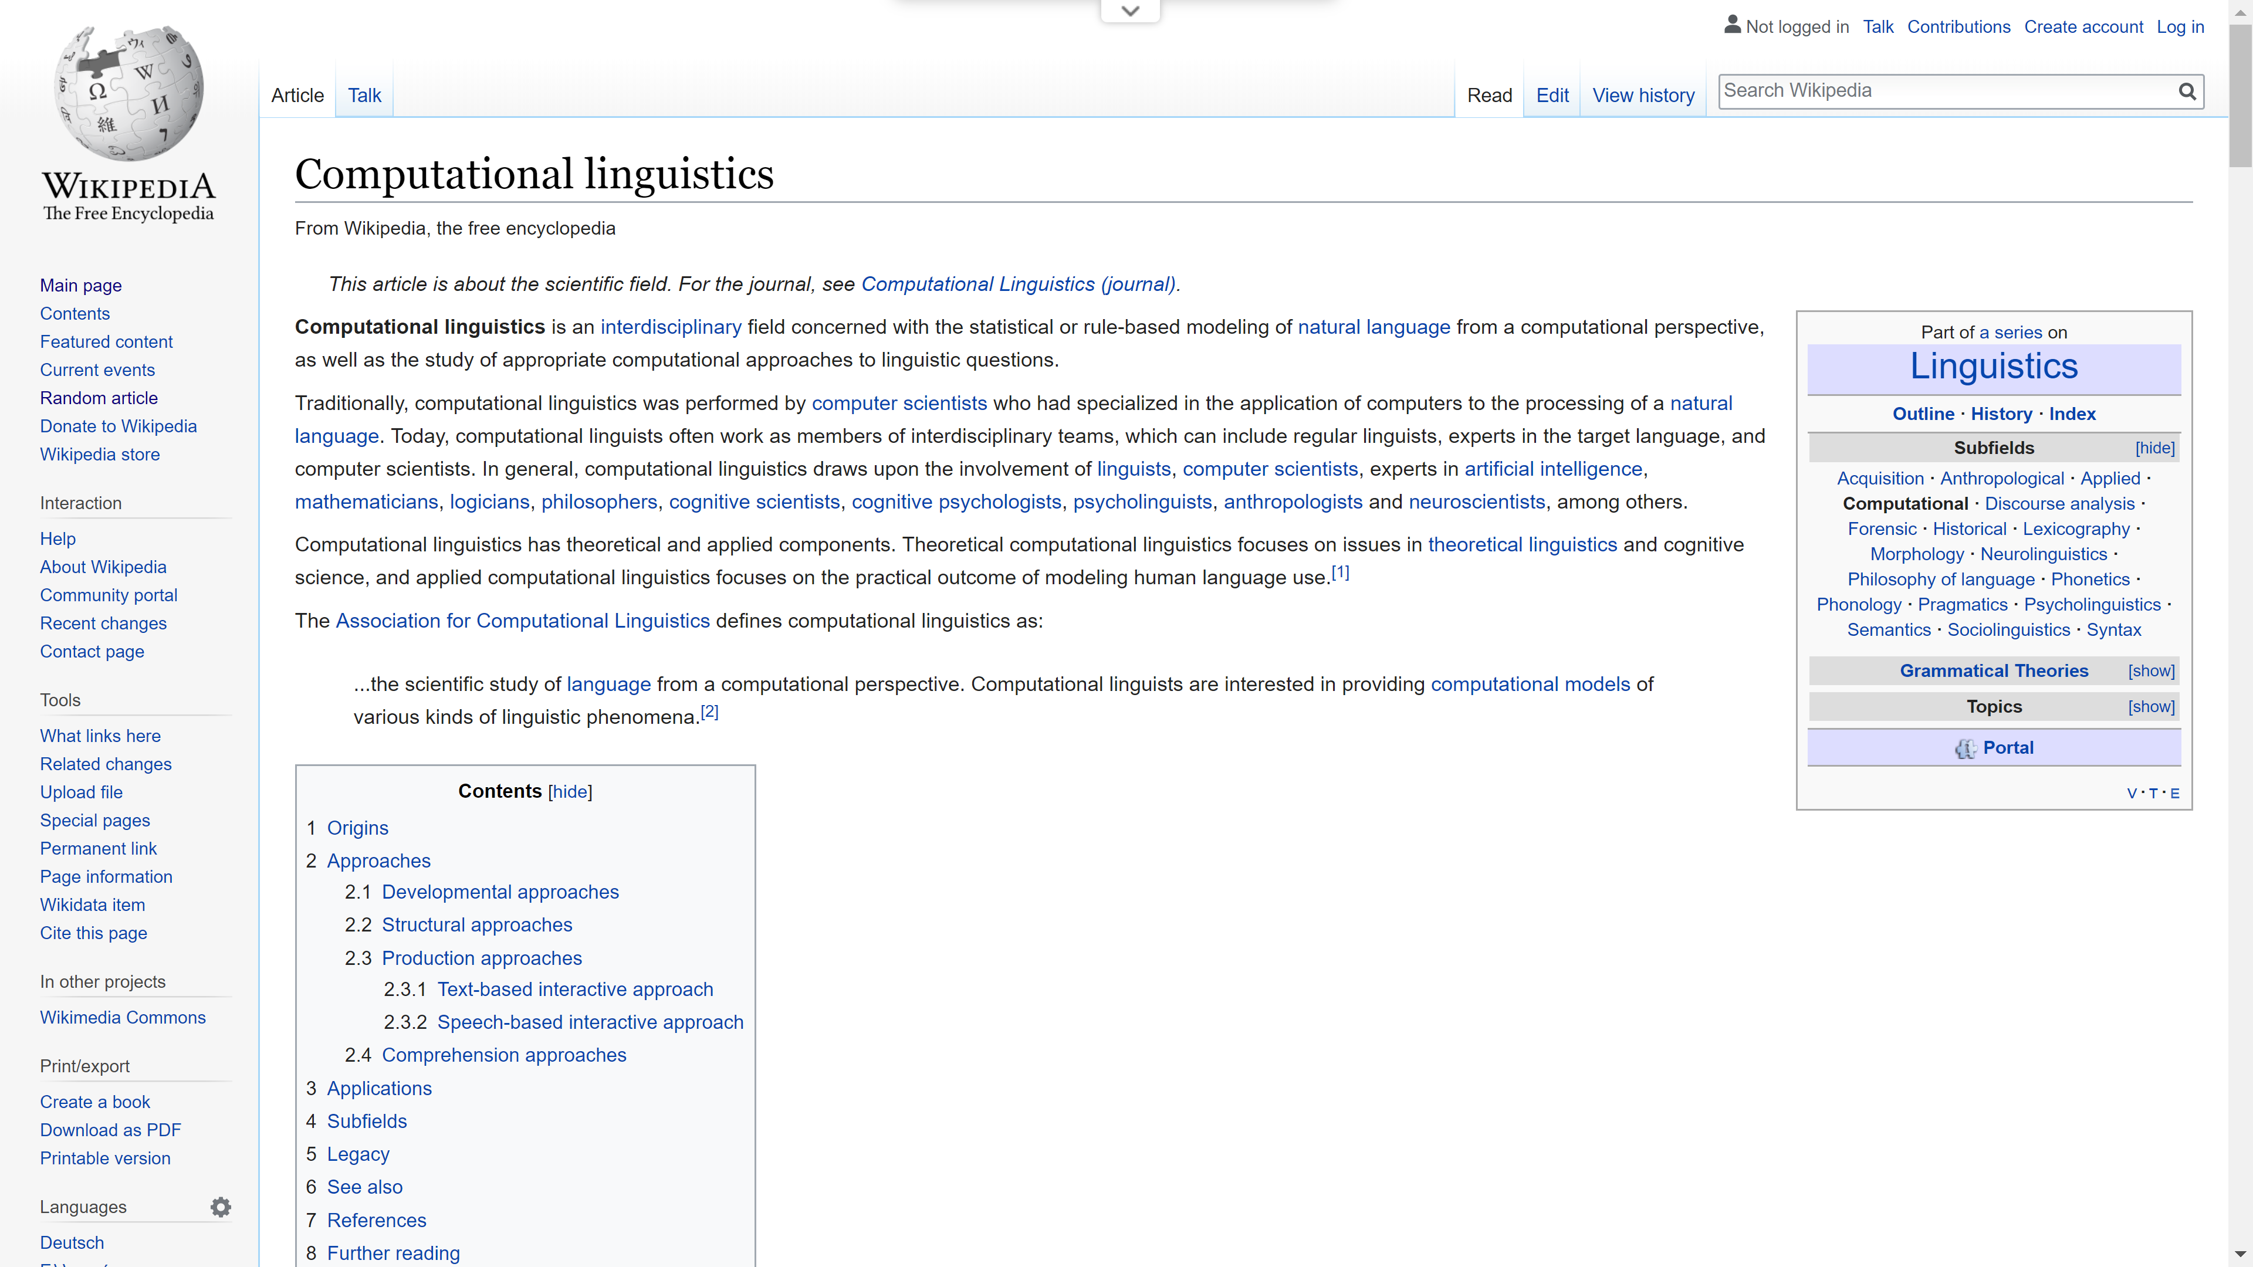
Notes:
In fact, Wikipedia distinguishes them
This is the kind of stigma I thought CL had

Slide 4
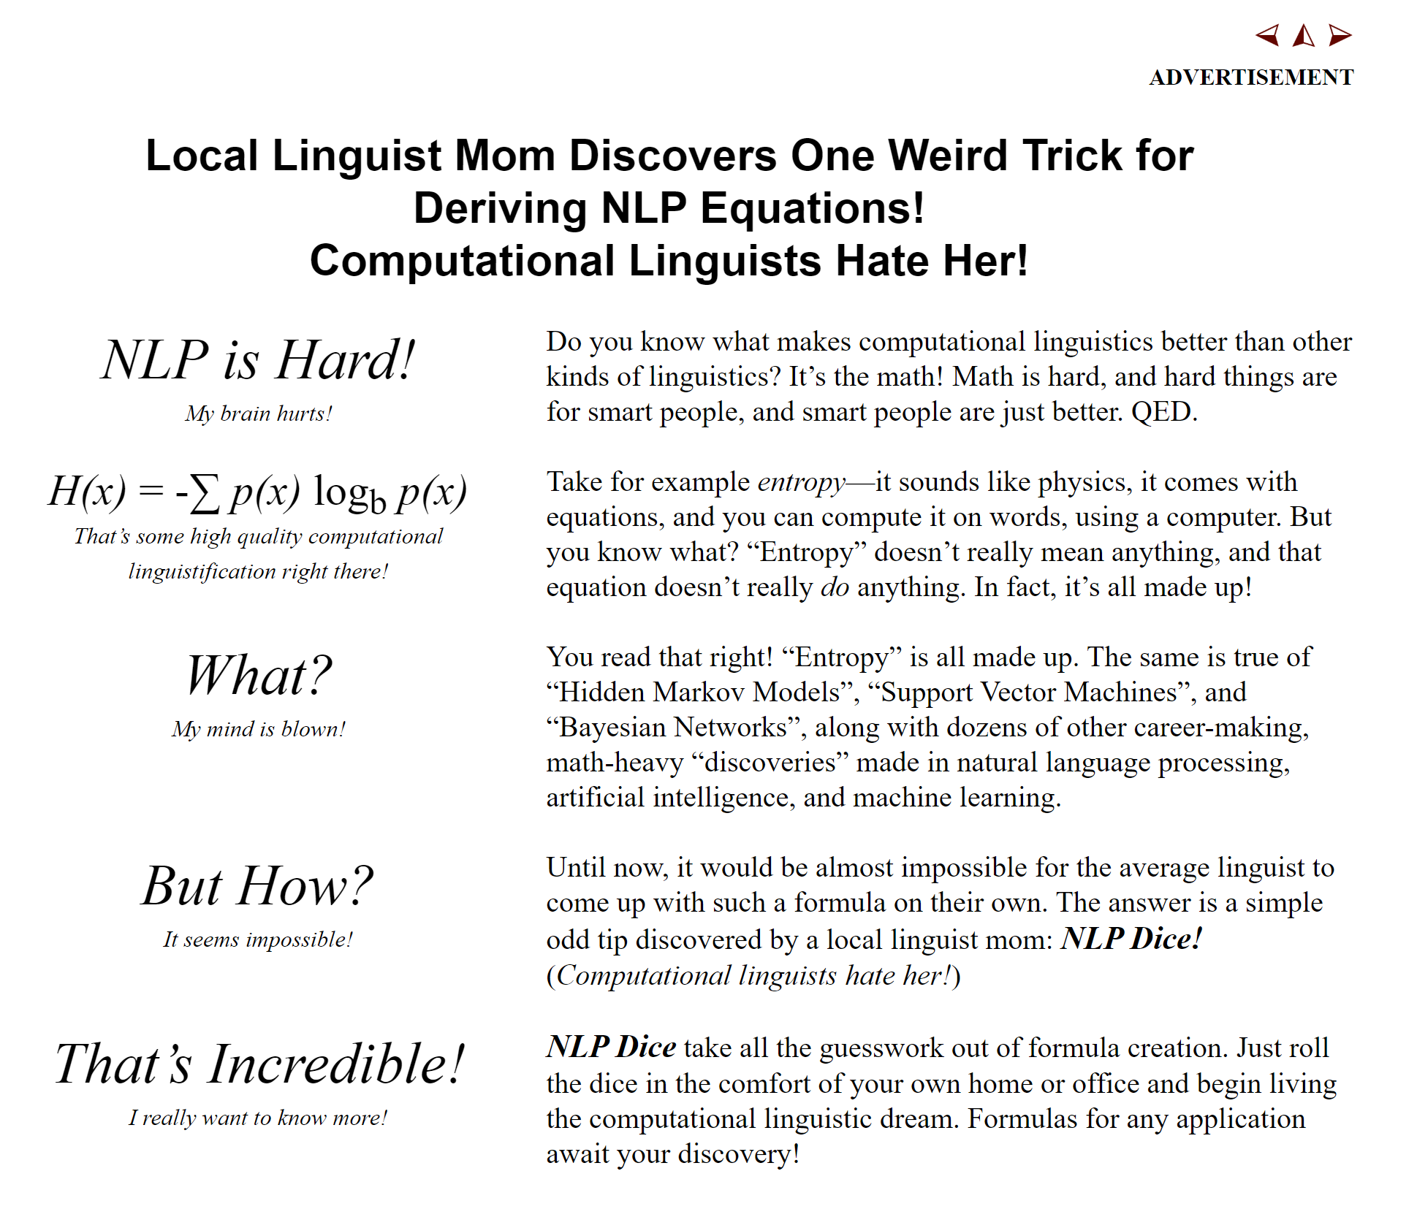

Slide 5
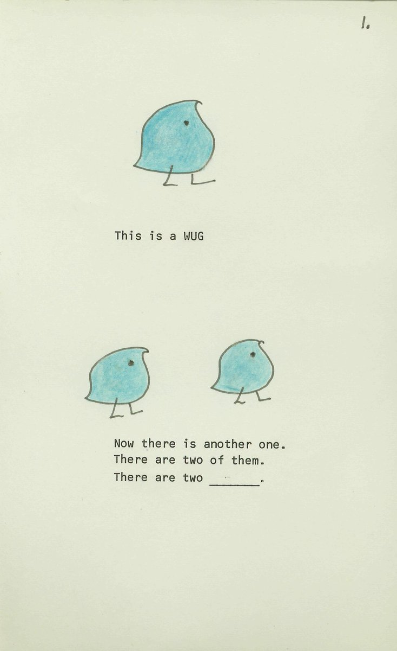
Language is complex!
Language needs a lot of context to be understood properly
Language-Game: Things don’t make sense if we don’t know what “game” we’re playing

Slide 6
List of people who think we could accurately represent the complexities of human language using computers
The US Government
Notes:
Then I got a job here and had to think differently
Who could ever think…

Slide 7
“[T]he computer has opened up to linguists a host of challenges, partial insights, and potentialities.”
ALPAC, 1966 (p.30)

Slide 8
“We have a lot of work to do.”
ALPAC, 1966 (essentially)

Slide 9
“We have a lot of work to do, so please keep funding us.”
ALPAC, 1966 (essentially, and more realistically)
Notes:
Let’s see how much further we’ve gotten with CL since then

Slide 10
Things to do with Computational Linguistics
Machine translation
Analyze usage of language
Extracting information from text
Speak to a computer and have it perform actions and help your patients, because you are a doctor
…and many more!
Understand How All of Human Language Works

Slide 11

Computational
Linguistics
Studying Language in a Way that is both Scientifically Rigorous and Respectful of Human Imperfection
Studying Language in a Way that is both Scientifically Rigorous and Respectful of Human Imperfection
Practical and
Mathematic Uses
of Computer Science
Practical and
Mathematic Uses
of Computer Science
Notes:
The way I used to look at it was that there was a sharp disconnect between
the way computer science looked at the world, which is full of problems to be solved using logic and mathematics
Linguistics, which seeks to understand the nature of one of the most fundamentally human characteristics

Slide 12
Computational Linguistics

Slide 13

Grammars
Named-Entity
Recognition
Syntax Parsing
Part of Speech tagging
Machine Learning
Language Acquisition
Discourse
Analysis
Phonological
Analysis
Language has Structure

Slide 14
The two main flavors of computational linguistics
Theoretical Computational Linguistics
Trying to learn about the structure of language using computational means
Applied Computational Linguistics
Using language and computers to solve practical problems
Notes:
Though now distinct, they came from the same root
We’re gonna start at where theoretical CL begins and end up with Applied CL

Slide 15
Modeling Language
Strings
A sequence of objects – whether words or sounds or characters, etc.
Formal Language
The set of “grammatical” strings
Formal Grammar
A set of rules used to create or validate those strings
Notes:
Formal languages descend from the idea of “grammaticality”, or that some utterances are grammatical and some are not

Slide 16
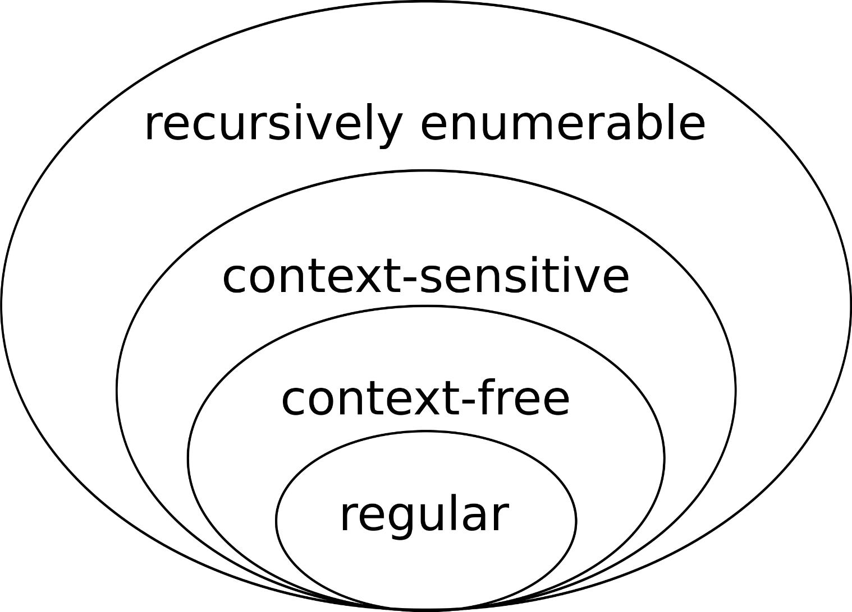
How do formal languages relate to each other?
The Chomsky Hierarchy

Slide 17
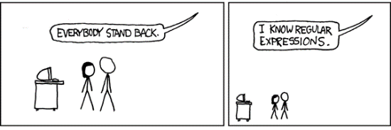
Lowest Level

Slide 18
End of slide show, click to exit

Slide 19
Regular Expressions
Can match one string or another string
Can match any character using a wildcard
Can match something a certain number of times
Can also match things no times, or infinite times, or both
((s?he said|what) ?)*

Slide 20
((s?he said|what) ?)*
he said what she said
what he said she said
he said what she said he said he said what what she said
what what what what what

Slide 21
Can they represent language?
No.
Language is too complex
There are structures that are mathematically impossible with regular expressions

Slide 22
Palindromes
Strings that are the same forwards and backwards
Given the letters D, M, A
How could we ensure that this was a palindrome, like MADAM or ADAMADA?
You can’t guarantee that the end will be the same as the beginning

Slide 23
Context-Free Grammars
More powerful than regular expressions
Can express all regular expressions
Often used to model language

Slide 24
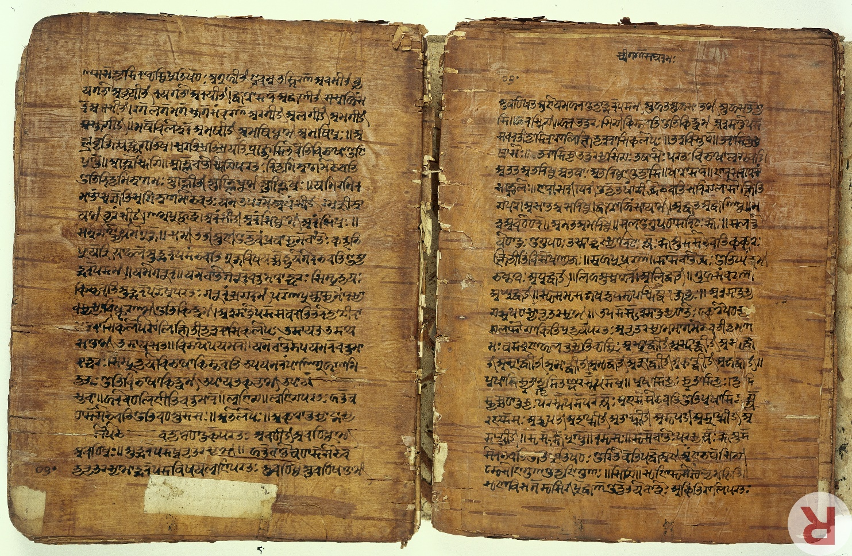
Pāṇini
Often considered the first linguist
Wrote the first context-free grammar in 7th to 4th century BCE

Slide 25
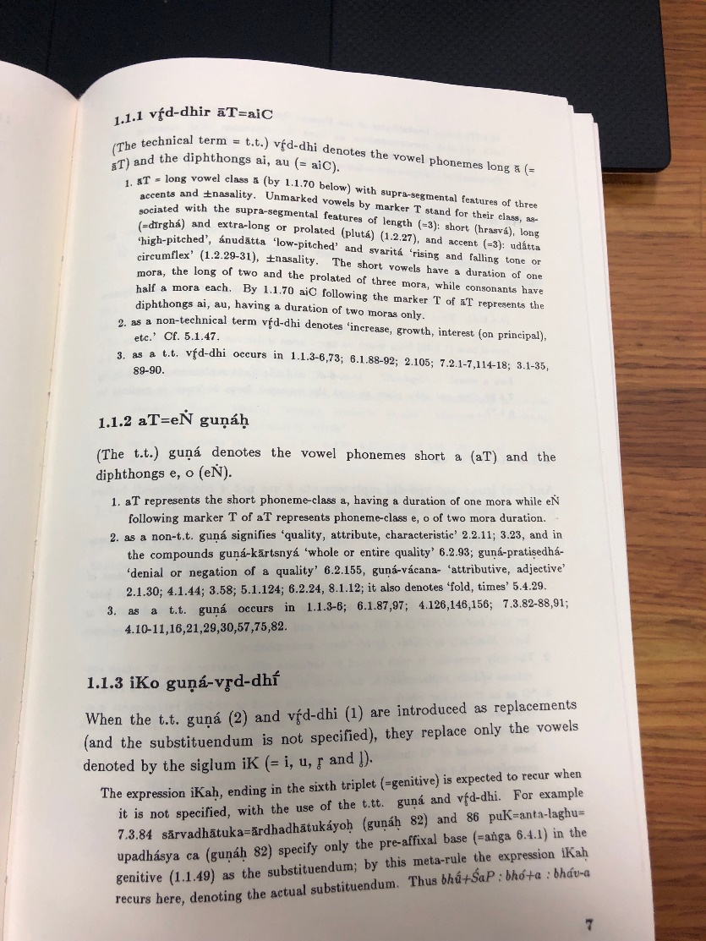

Slide 26
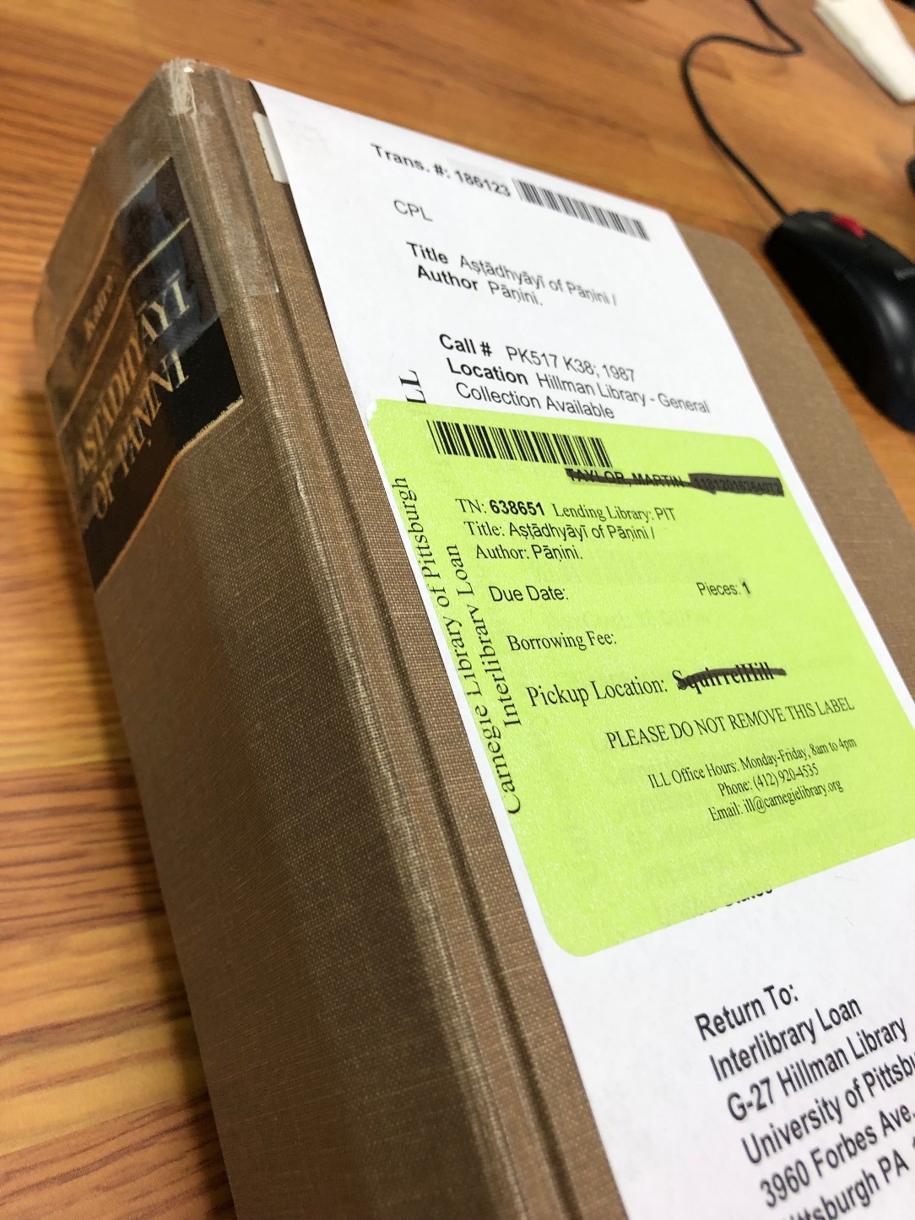

Slide 27
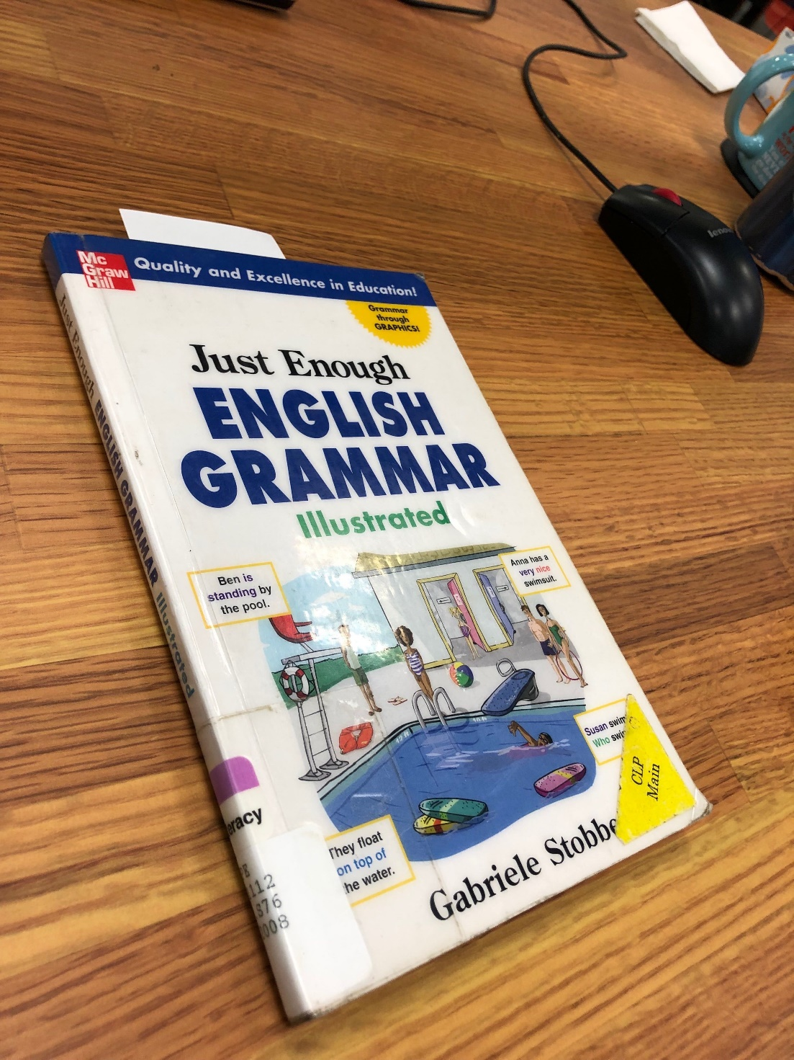

Slide 28
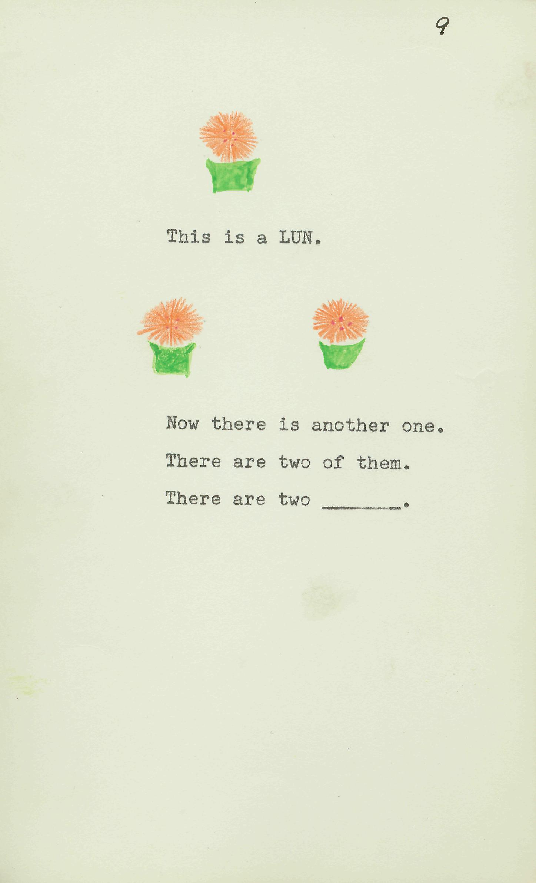
Just Enough Context-Free Grammar
There are two <pluralNoun>.
<pluralNoun> = <noun>s
<noun> =

Slide 29
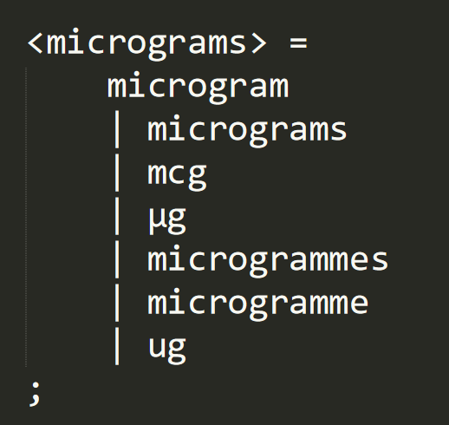
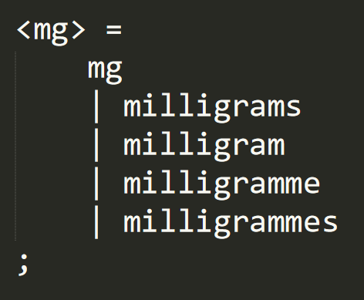
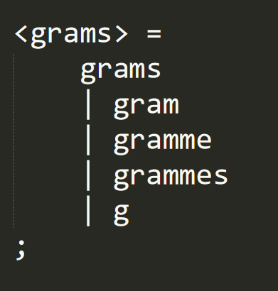
Actual M*Modal Grammars

Slide 30
Actual M*Modal Grammars
Notes:
This is from the frequency grammar

Slide 31
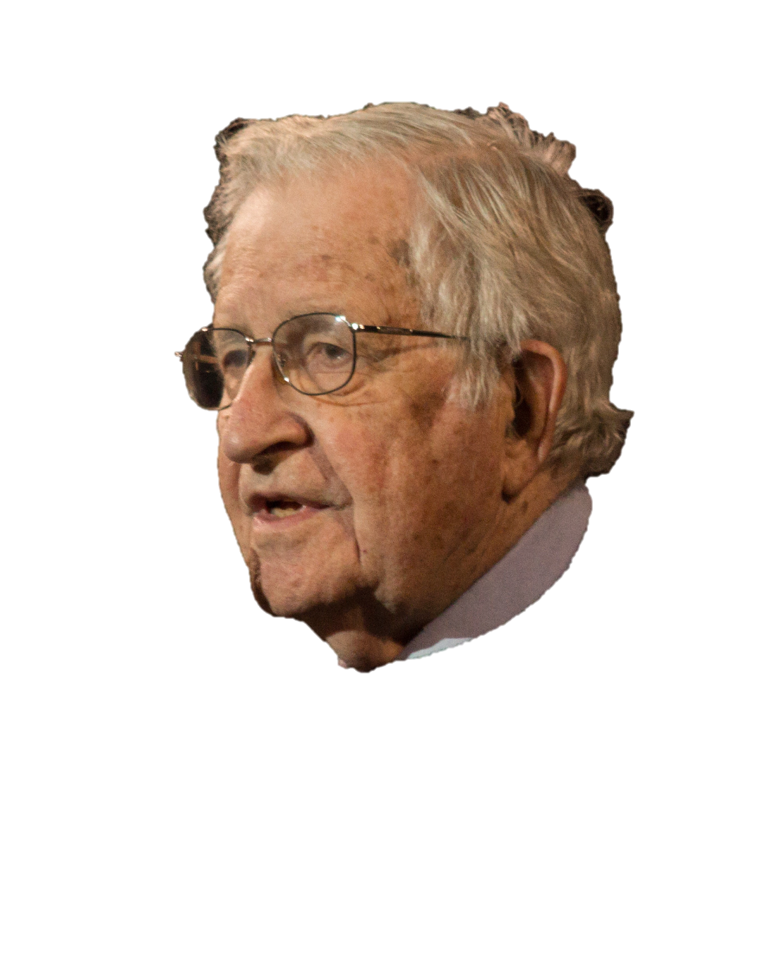
Can they represent Language?
Not exactly, but they can do the job
Well…

Slide 32
List of people who think we could accurately represent the complexities of human language using computers
The US Government
Noam Chomsky
Notes:
Then I got a job here and had to think differently
Who could ever think…

Slide 33
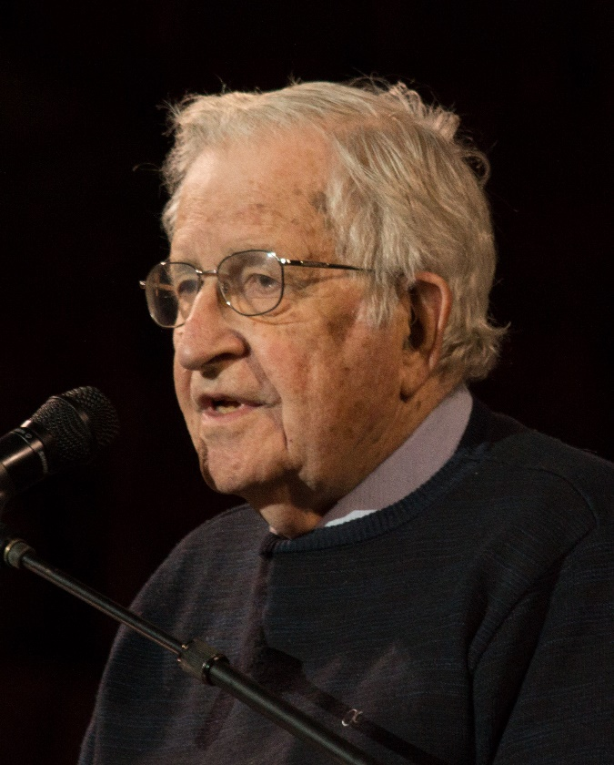
Transformational Grammars
Made by Noam Chomsky – American linguist
Context-Free Grammars that edit not only strings, but also their own rules.
Founded the linguistic framework of generativism & essentially turned computational linguistics on its head

Slide 34
English Passivization
I ate the apple ⇒ The apple was eaten (by me)
<Noun Phrase 1> <Verb> <Noun Phrase 2>
⇓
<Noun Phrase 2> <BE> <Verb> (by <Noun Phrase 1>)

Slide 35
Context-Sensitive Grammars & Turing Machines
Where are Transformational Grammars on the Chomsky hierarchy?
They are extremely powerful…
…too powerful

Slide 36
Can we use language, even if we don’t fully understand how it works?
Yes.

Slide 37

Natural Language Processing
A very broad term meaning “computers are finding, understanding, and using the language in input”
NLP subjects include:
Part of Speech tagging
Syntax Parsing
Word Segmentation
Named Entity Recognition
Discourse Analysis
Notes:
The more people used computers, the more we wanted them to be as versed in language as we were

Slide 38
“You shall know a word by the company it keeps!”
John R. Firth, 1957
Notes:
Distributional semantics

Slide 39
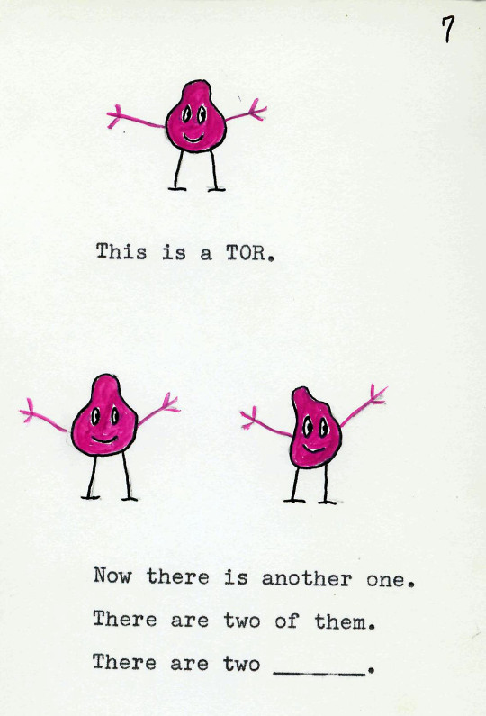
Machine Learning
Instead of teaching a computer the language, tell the computer to learn the language itself
Supervised learning
Give the machine input and output and tell it to turn one into the other
Unsupervised learning
Just give it input and let it find patterns on its own
Notes:
This “baptism by fire” method

Slide 40
From Skeptic to Computational Linguist
Computers, like language, are tools
Computational linguistics is more about bringing the computer into language than bringing language into the computer.
M*Modal has always been the forefront of this
Notes:
Realizing that computational linguistics is a way to harness language put it on my good side.
Computational linguistics is more so an act of communication than an act of computation; it’s bringing the computer into human communication to augment it, not corrupt it.
We at M*Modal understand this. Thank you.

